Slide 1


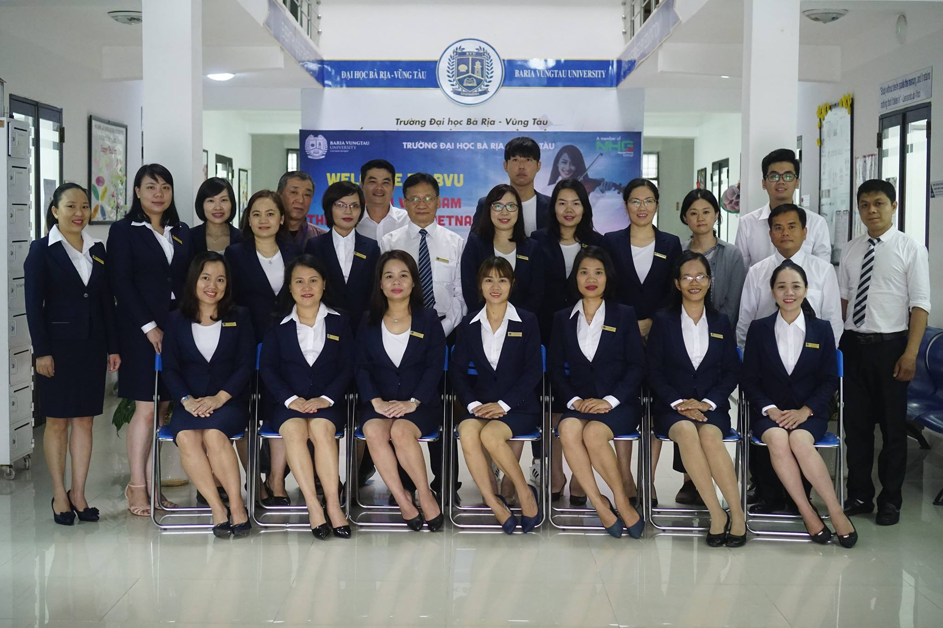

Slide 2

AMERICAN JETSTREAM PRE-INTERMEDIATE B

Slide 3
TEACHER’S PERSONAL INFORMATION
Name: Nguyen Thanh Loan
Facebook: Loan Nguyễn Thanh
Mobile number: 0942 255 937
Email: loannguyenthanh1978@gmail.com

Slide 4
UNIT 11
Vocabulary Plus
Language in action

Slide 5

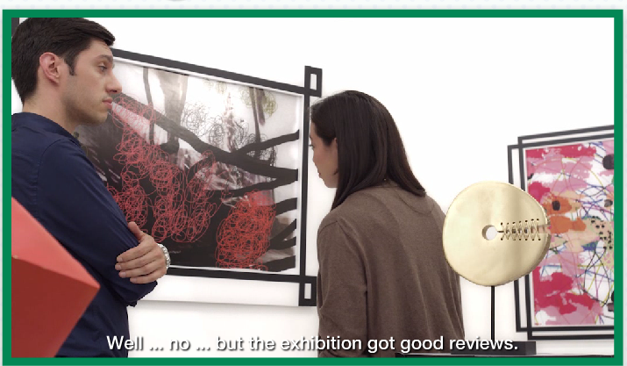
Vocabulary Plus
Language in action

Slide 6

VOCABULARY PLUS
The arts
Phrases about the art
Direct a play
perform a play
Direct a movie
see a play
see a movie
Do a painting
write a play
Go to the theatre
write a movie script
Go to the movie
write a poem
Make a sculpture

Slide 7
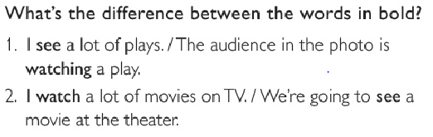
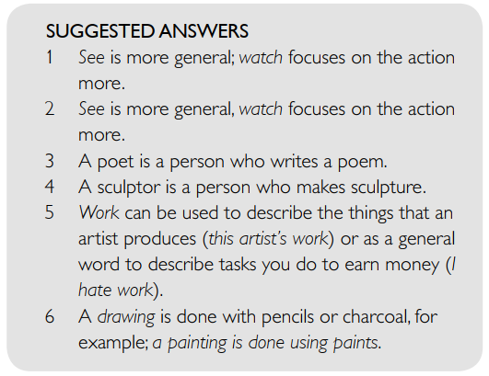
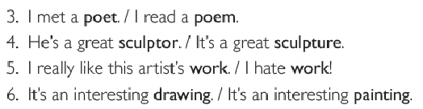
The arts

Slide 8
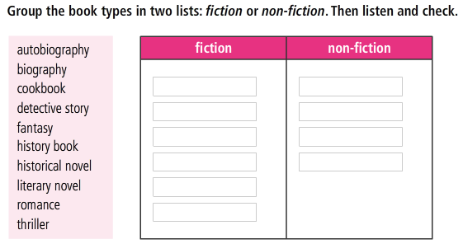
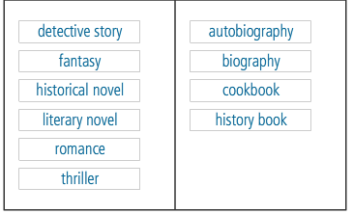
VOCABULARY PLUS
Book types

Slide 9
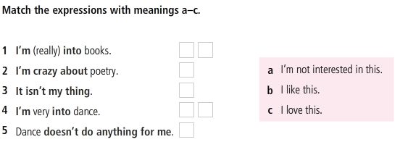

VOCABULARY PLUS
Useful expressions

Slide 10
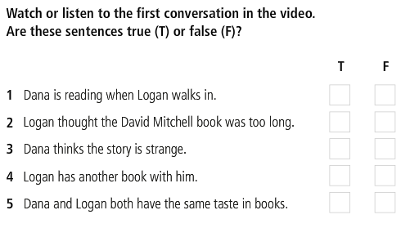
LANGUAGE IN ACTION
Expressing strong feelings

Slide 11
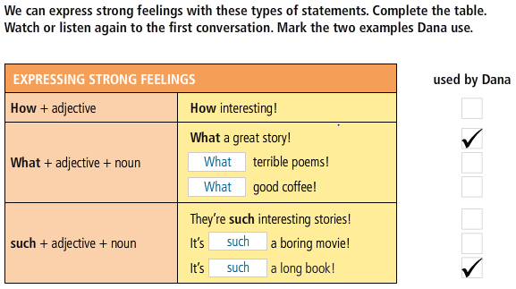
Expressing strong feelings

Slide 12
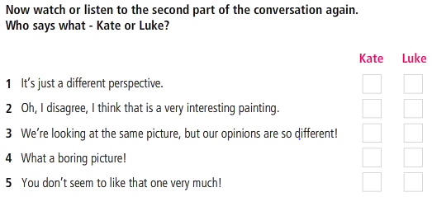








Expressing strong feelings

Slide 13
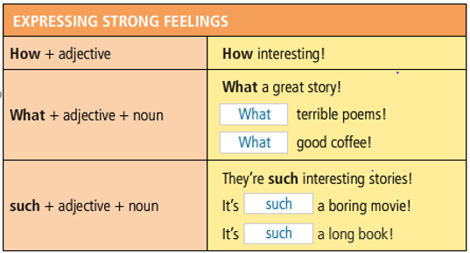
Expressing strong feelings

Slide 14
REFERENCES
Vocabulary: The arts
https://www.youtube.com/watch?v=P9LchEo9byQ
https://www.youtube.com/watch?v=QZQyV9BB50E
Vocabulary: exclamations for strong feelings
https://www.youtube.com/watch?v=PbQ24M1e2J0
Listening: Arts in our everyday lives
https://www.youtube.com/watch?v=QZQyV9BB50E
https://www.youtube.com/watch?v=dtdjd0L4uO0

